Slide 1
Boston House Price Prediction: A Regression Approach
By
Anubhav Shankar (01951462)

Slide 2
Problem Statement
The project undertaking is to understand the workings and mechanisms of Linear Regression, especially Lasso and Ridge Regression
Linear Regression is a powerful methodology that can come especially handy when doing causality analysis for predictive purposes
In this case, we’ll try to predict the price of houses in Boston from a set of collected variables which are deemed to affect the price of a property.

Slide 3
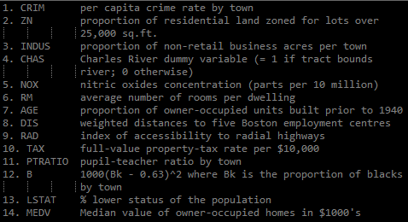
Data Description
The dataset consists of 506 observations contained within 14 fields/variables. The variable descriptions is provided below.

Slide 4
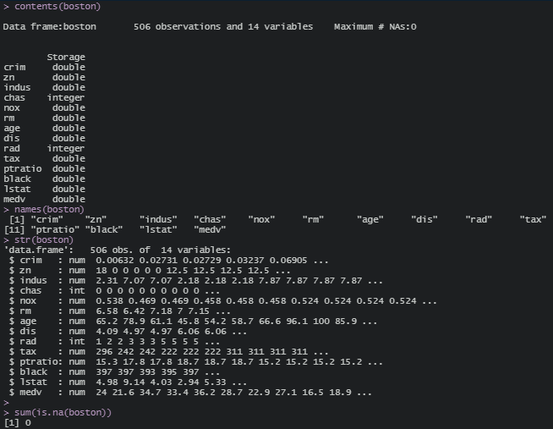
Data Description (Contd.)

Slide 5
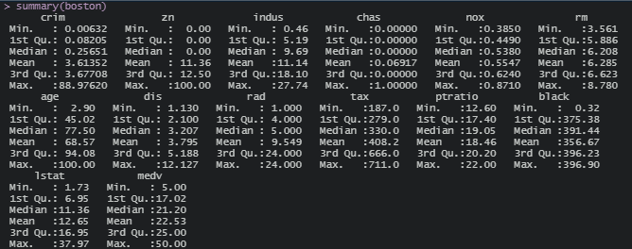
Summary Statistics

Slide 6
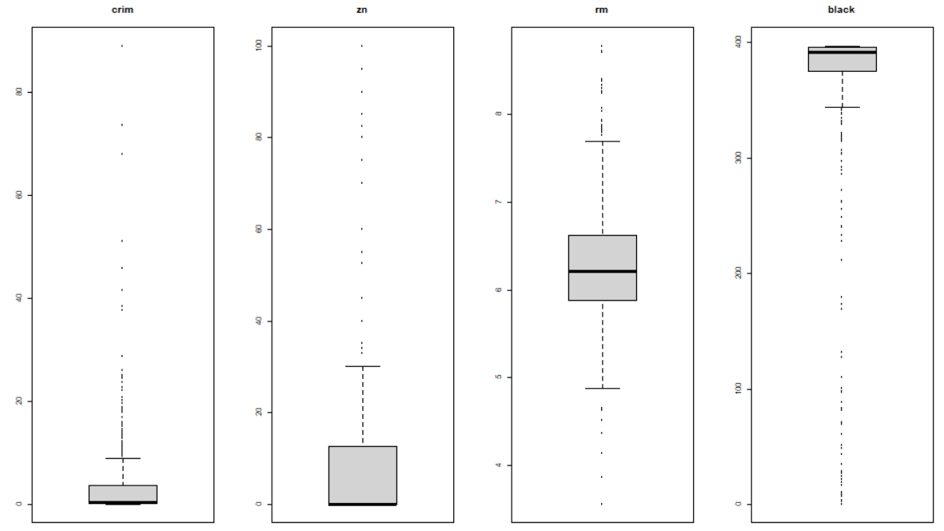
Summary Statistics (Contd.)

Slide 7
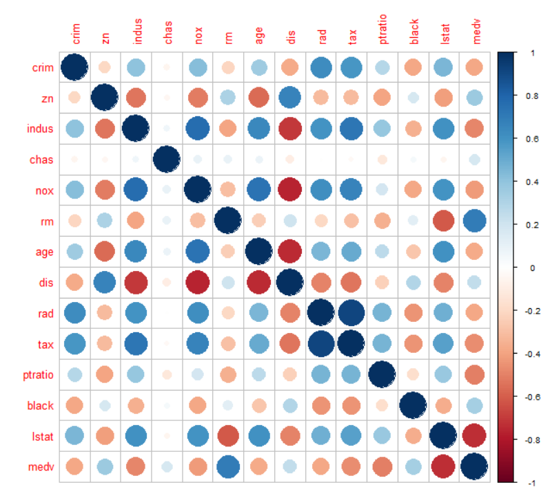
Summary Statistics (Contd.)

Slide 8
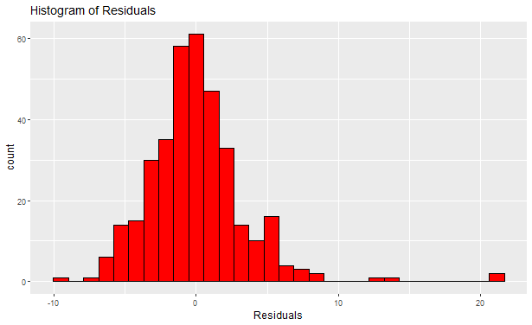
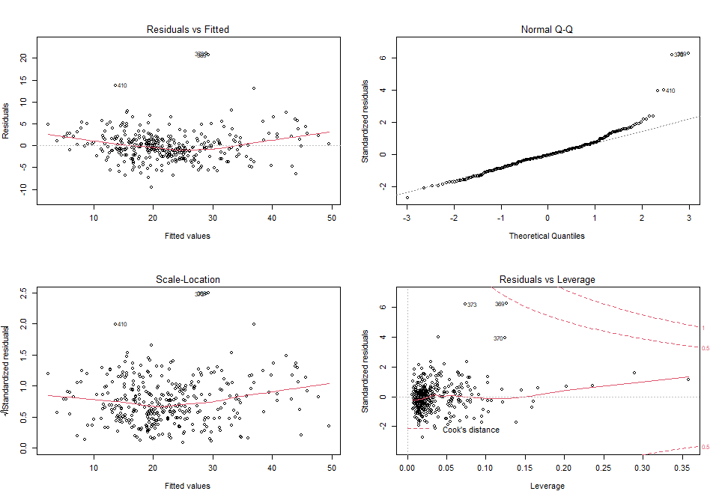
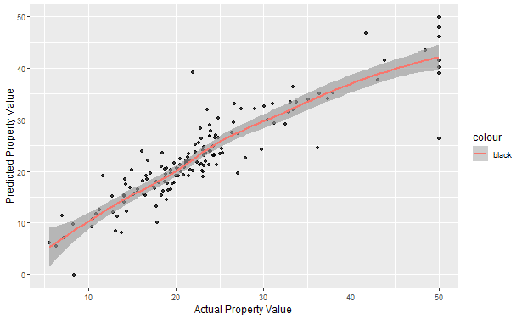
Multivariate Linear Regression
Mathematically,
Medv = -26.88 + (-0.115) * crim + 2.73 * chas + (-13.20) * nox + 11.85 * rm + (-0.74) * dis + 2.71 * rad + (-0.008) * tax + (-0.625) * ptratio + 1.83 * lstat + (-0.327) * (rm:lstat) + (-0.314) * (rm:rad) + (-0.035) * (rad:lstat)

Slide 9
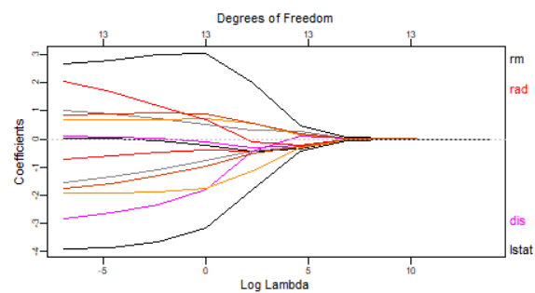
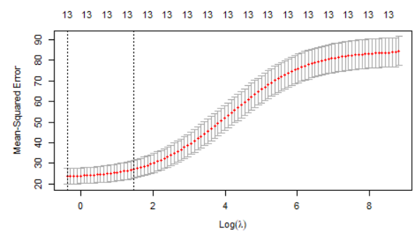
Ridge Regression
Mathematically,
Medv = 22.53 + (-0.42) * crim + 0.26 * zn + (-0.379) * indus + 0.702 * chas + (-0.693) * nox + 2.636 * rm + (-0.406) * age + (-0.966) * dis + 0.153 * rad + (-0.512) * tax + (-1.476) * ptratio + 0.718 * black + (-2.307) * lstat

Slide 10
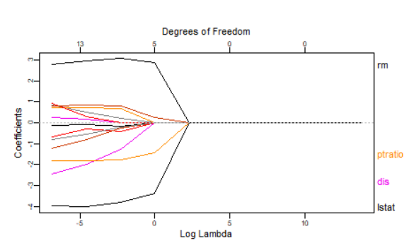
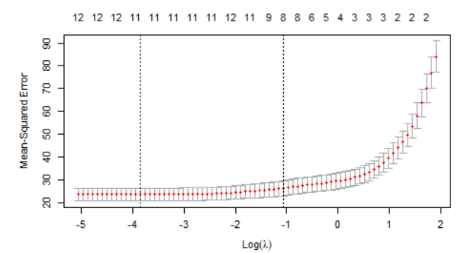
Lasso Regression
Mathematically,
Medv = 22.53 + (-0.295) * crim + 0.15 * zn + (-0.122) * indus + 0.489 * chas + (-0.190) * nox + 3.01 * (rm) + 0.003 * age + (-0.917) * dis + (-0.167) * tax + (-1.68) * ptratio + 0.642 * black + (-3.678) * lstat

Slide 11
Summary Table: Ridge & Lasso Regression
 | Ridge Regression (α = 0) | Lasso Regression (α = 1)
min λ | 0.678 | 0.0212
1se λ (optimal lambda, λ*)) | 4.356725 | 0.345263
MSE (at λ*) | 26.301543 | 22.769636
RMSE (at λ* ) | 5.128503 | 4.771754

Slide 12
Summary Table: Multivariate Linear Regression
Statistic | Multiple Regression
 | Train | Test
MSE | 12.02844 | 16.946752
RMSE | 3.468205 | 4.116643
RSS | 4258.069 | -
RSE | 3.533696 | -
R^2 | 0.8545 | -
Adj. R^2 | 0.8494 | -
F-Statistic | 166.9 | -

